Slide 1
Data mining functionalities
ITE404 - Data Warehousing and Data Mining

Slide 2
Introduction
Data mining functionalities are used to specify the kind of patterns to be found in data mining tasks.
Data mining tasks → classified into two categories: descriptive and predictive.
Descriptive mining tasks characterize the general properties of the data in the database.
Predictive mining tasks perform inference on the current data in order to make predictions.
ITE404 - Data Warehousing and Data Mining

Slide 3
Functionalities/Techniques
Concept/Class Description: Characterization and Discrimination
Mining Frequent Patterns, Associations and correlations
Classification and Prediction
Cluster Analysis
Outlier Analysis
Evolution Analysis
ITE404 - Data Warehousing and Data Mining

Slide 4
Concept/Class Description: Characterization and Discrimination
Data → associated with classes or concepts.
For example, in the Electronics store, classes of items for sale include computers and printers, and concepts of customers include bigSpenders and budgetSpenders.
Useful to describe individual classes and concepts in summarized, concise, and yet precise terms. Such descriptions of a class or a concept are called class/concept descriptions.
ITE404 - Data Warehousing and Data Mining

Slide 5
Contd….
These descriptions can be derived via
(1) data characterization, by summarizing the data of the class under study (often called the target class) in general terms, or
(2) data discrimination, by comparison of the target class with one or a set of comparative classes (often called the contrasting classes), or
(3) both data characterization and discrimination.
ITE404 - Data Warehousing and Data Mining

Slide 6
Concept/Class Description: Characterization and Discrimination
Data Characterization: A data mining system should be able to produce a description summarizing the characteristics of customers.
Example: The characteristics of customers who spend more than $1000 a year at (some store called ) AllElectronics. The result can be a general profile such as age, employment status or credit ratings.
ITE404 - Data Warehousing and Data Mining

Slide 7
Contd….
Data Discrimination: It is a comparison of the general features of targeting class data objects with the general features of objects from one or a set of contrasting classes. User can specify target and contrasting classes.
Example: The user may like to compare the general features of software products whose sales increased by 10% in the last year with those whose sales decreased by about 30% in the same duration.
ITE404 - Data Warehousing and Data Mining

Slide 8
Contd….
The output of data characterization can be presented in various forms.
Examples include pie charts, bar charts, curves, multidimensional data cubes, and multidimensional tables, including crosstabs.
The resulting descriptions can also be presented as generalized relations or in rule form(called characteristic rules).
ITE404 - Data Warehousing and Data Mining

Slide 9
Mining Frequent Patterns, Associations and correlations
Frequent Patterns : As the name suggests patterns that occur frequently in data.
Frequent Itemset : A set of items that frequently appear together in a transactional data set, such as milk and bread.
Frequent Sequential Pattern : A frequently occurring subsequence, such as the pattern that customers tend to purchase first a PC, followed by a digital camera, and then a memory card.
ITE404 - Data Warehousing and Data Mining

Slide 10
Contd….
Substructure : Refer to different structural forms, such as graphs, trees, or lattices, which may be combined with itemsets or subsequences.
If a substructure occurs frequently, it is called a (frequent) structured pattern.
Mining frequent patterns leads to the discovery of interesting associations and correlations within data.
ITE404 - Data Warehousing and Data Mining

Slide 11
Contd….
Association Analysis: from marketing perspective, determining which items are frequently purchased together within the same transaction.
Example: An example is mined from the (some store) AllElectronic transactional database.
buys (X, “Computers”) ➔ buys (X, “software”) [Support = 1%, confidence = 50% ]
X represents customer
Confidence or certainty = 50% , if a customer buys a computer there is a 50% chance that he/she will buy software as well.
Support = 1%, means that 1% of all the transactions under analysis showed that computer and software were purchased together.
ITE404 - Data Warehousing and Data Mining

Slide 12
Are All the “Discovered” Patterns Interesting?
Data mining may generate thousands of patterns: Not all of them are interesting
  Suggested approach: Human-centered, query-based, focused mining
Interestingness measures
  A pattern is interesting if it is easily understood by humans, valid on new or test data with some degree of certainty, potentially useful, novel, or validates some hypothesis that a user seeks to confirm
Objective vs. subjective interestingness measures
  Objective: based on statistics and structures of patterns, e.g., support, confidence, etc.
  Subjective: based on user’s belief in the data, e.g., unexpectedness, novelty, actionability, etc.
ITE404 - Data Warehousing and Data Mining

Slide 13
Contd…
Support → usefulness
Confidence → certainty
The support for a rule R is the ratio of the number of occurrences of R, given all occurrences of all rules.
The confidence of a rule X → Y, is the ratio of the number of occurrences of Y given X, among all other occurrences given X
In multidimensional databases, where each attribute is referred to as a dimension, the above rule can be referred to as a multidimensional association rule.
ITE404 - Data Warehousing and Data Mining

Slide 14
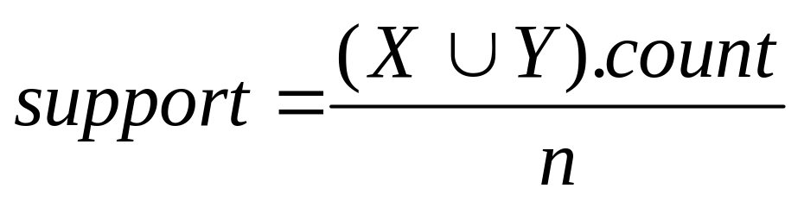
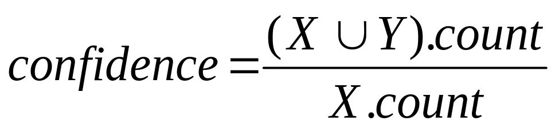
Support and Confidence
Support count: The support count of an itemset X, denoted by X.count, in a data set T is the number of transactions in T that contain X. Assume T has n transactions.
Then,
ITE404 - Data Warehousing and Data Mining

Slide 15
Contd….
Bag
Books
Bag
Bag
Uniform
Bag
Crayons
Books
Uniform
Pencil
Uniform
Bag
Uniform
Pencil
Crayons
Pencil
Uniform
Crayons
Crayons
Uniform
Crayons
Uniform
Pencil
Book
Bag
Book
Bag
Bag
Pencil
Books
Support for {Bag, Uniform} =
5/10 = 0.5
Confidence for Bag → Uniform =
5/8 = 0.625
ITE404 - Data Warehousing and Data Mining

Slide 16
  t1: Beef, Chicken, Milk
  t2: Beef, Cheese
  t3: Cheese, Boots
  t4: Beef, Chicken, Cheese
  t5: Beef, Chicken, Clothes, Cheese, Milk
  t6: Chicken, Clothes, Milk
  t7: Chicken, Milk, Clothes
Clothes → Milk, Chicken
Clothes, Chicken → Milk
ITE404 - Data Warehousing and Data Mining

Slide 17
Contd…
Motivation: Finding inherent regularities in data
  What products were often purchased together?— Bag, Uniform?!
  What are the subsequent purchases after buying a PC?
  What kinds of DNA are sensitive to this new drug?
  Can we automatically classify web documents?
ITE404 - Data Warehousing and Data Mining

Slide 18
Mining Frequent Patterns, Associations and correlations
Another example:
Age (X, 20…29) ^ income (X, 20K-29K) ➔ buys(X, “CD Player”) [Support = 2%, confidence = 60% ]
Customers between 20 to 29 years of age with an income $20000-$29000. There is 60% chance they will purchase CD Player and 2% of all the transactions under analysis showed that this age group customers with that range of income bought CD Player.
ITE404 - Data Warehousing and Data Mining

Slide 19
Classification and Prediction
Classification is the process of finding a model that describes and distinguishes data classes or concepts for the purpose of being able to use the model to predict the class of objects whose class label is unknown.
  Construct models (functions) that describe and distinguish classes or concepts for future prediction
Training data → Building the model
Test data → Evaluate the model
Classification model can be represented in various forms such as
        IF-THEN Rules
        A decision tree
        Neural network
ITE404 - Data Warehousing and Data Mining

Slide 20
Contd….
A decision tree is a flow-chart-like tree structure, where each node denotes a test on an attribute value, each branch represents an outcome of the test, and tree leaves represent classes or class distributions.
Decision trees can easily be converted to classification rules.
A neural network, when used for classification, is typically a collection of neuron-like processing units with weighted connections between the units.
ITE404 - Data Warehousing and Data Mining

Slide 21
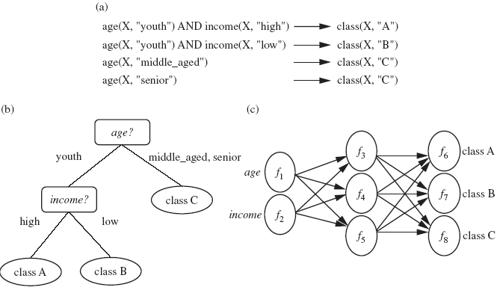
Classification Model
ITE404 - Data Warehousing and Data Mining

Slide 22
Cluster Analysis
Clustering analyses data objects without consulting a known class label.
Groups data elements into different groups based on the similarity between elements within a single group
Maximizing the intraclass similarity and minimizing the interclass similarity.
Example: Result analysis
ITE404 - Data Warehousing and Data Mining

Slide 23
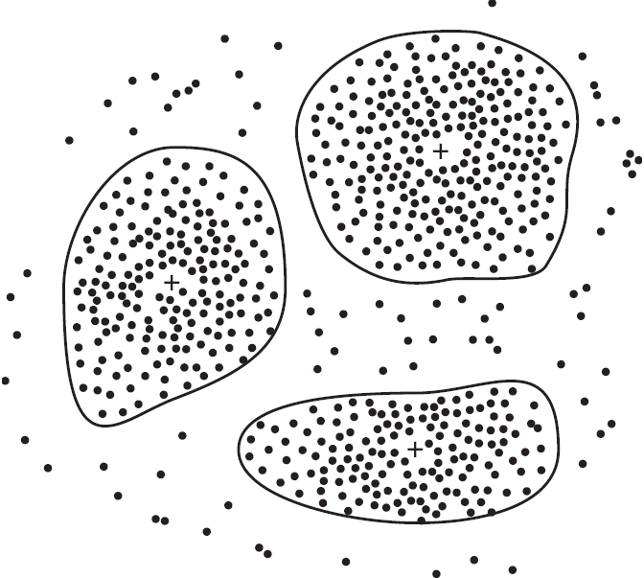
Cluster Analysis
ITE404 - Data Warehousing and Data Mining

Slide 24
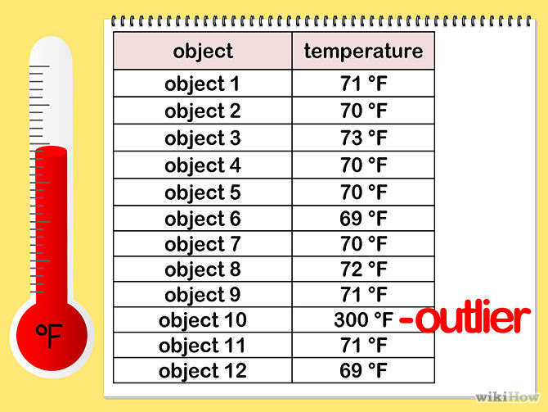

Outlier Analysis
Outlier Analysis : A database may contain data objects that do not comply with the general behavior or model of the data. These data objects are outliers.
Outliers" are values that "lie outside" the other values.
Example: Use in finding Fraudulent usage of credit cards. Outlier Analysis may uncover Fraudulent usage of credit cards by detecting purchases of extremely large amounts for a given account number in comparison to regular charges incurred by the same account. Outlier values may also be detected with respect to the location and type of purchase or the purchase frequency.
ITE404 - Data Warehousing and Data Mining

Slide 25
Evolution Analysis
Evolution Analysis: Data evolution analysis describes and models regularities or trends for objects whose behavior changes over time.
Example: Time-series data. If the stock market data (time-series) of the last several years available from the New York Stock exchange and one would like to invest in shares of high tech industrial companies. A data mining study of stock exchange data may identify stock evolution regularities for overall stocks and for the stocks of particular companies. Such regularities may help predict future trends in stock market prices, contributing to one’s decision making regarding stock investments.
ITE404 - Data Warehousing and Data Mining

